Slide 1
SQL PROJECT

Slide 2
Introduction to Capstone Project: Chinook Music Store Analysis
In the realm of data analytics and business intelligence, practical projects play a pivotal role in honing skills and gaining real-world experience. This capstone project focuses on analyzing data from the Chinook Music Store, a fictional online store, to derive valuable insights that can inform business decisions and strategies.
Project Overview: The Chinook Music Store Analysis project aims to explore and analyze various aspects of the music store's operations using data-driven approaches. By leveraging the Chinook database, which simulates a real-world scenario of a music store, participants will delve into the data to uncover patterns, trends, and opportunities for optimization.

Slide 3
Metadata
The Chinook database consists of the following tables, each containing specific types of data related to a music store:
albums: Contains information about music albums, including AlbumId, Title, and ArtistId.
artists: Stores details about music artists, including ArtistId and Name.
customers: Contains customer information such as CustomerId, FirstName, LastName, and Country.
employees: Stores information about employees, including EmployeeId, FirstName, LastName, and Title.
genres: Stores music genres, including GenreId and Name.
invoice_items: Contains details about items purchased in invoices, including InvoiceItemId, InvoiceId, TrackId, UnitPrice, and Quantity.
invoices: Stores information about invoices, including InvoiceId, CustomerId, InvoiceDate, and Total.
media_types: Contains different media types such as MPEG audio, AAC audio, etc., with columns MediaTypeId and Name.
playlist_track: Represents the many-to-many relationship between playlists and tracks, with PlaylistId and TrackId.
playlists: Stores information about playlists, including PlaylistId and Name.
tracks: Contains information about individual tracks, including TrackId, Name, AlbumId, GenreId, Composer, and Milliseconds.

Slide 4
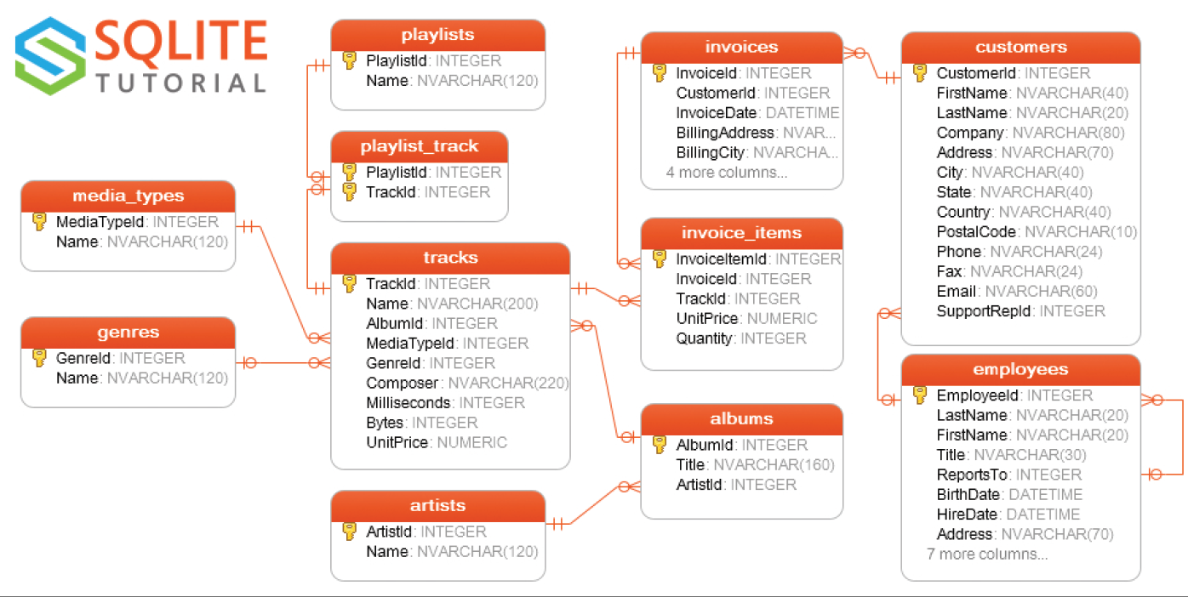
Entity Relationship Diagram

Slide 5
Queries/KPIs
1. Top Selling Genres:
Which music genres have the highest total sales amount?
2. Sales Trends Over Time:
How have sales been trending over the years? (Use invoice table)
3. Customer Distribution by Country:
What is the distribution of customers by country? (Use a map visual)
4. Artist Popularity:
Who are the top 10 most popular artists based on the number of tracks sold? (Use their Full names)
5. Employee Sales Performance:
How does the sales performance vary among employees?
6. Album vs. Individual Track Sales:
Are albums or individual tracks more popular among customers?
Visualize the percentage of album sales compared to individual track sales.
7. Sales by Genre and Year:
How have sales for each genre evolved over the years?
Visualize the total sales amount for each genre, grouped by year.
8. Customer Purchasing Habits:
What are the purchasing habits of customers in terms of the number of tracks per purchase?
Visualize the distribution of the number of tracks per purchase.
9. Popular Playlists:
Which playlists are the most popular among customers?
Visualize the number of tracks included in each playlist.
10. Genre Distribution in Playlists:
What is the distribution of music genres in playlists?
Visualize the percentage of each genre in all playlists.
6. Sales by Genre and Year:
How have sales for each genre evolved over the years?
7. Customer Purchasing Habits:
What are the purchasing habits of customers in terms of the number of tracks per purchase?
8. Popular Playlists:
Which playlists are the most popular among customers?
9. Genre Distribution in Playlists:
What is the distribution of music genres in playlists?
10. Customer Lifetime Value:
What is the total purchase amount and number of purchases made by each customer, along with their lifetime value? (Calculate the average purchase amount per customer to 2.dp)

Slide 6
Instructions
Ensure the use of proper Aliases. i.e., name each column appropriately.
Design a powerpoint file, a slide for each KPI showing the queries you wrote and the resulting table and a little bit of your analysis/findings as you answer each question
Use Blue and White as your theme colour for the powerpoint slide
Reach out if you have any questions/clarifications

